Slide 1
Improving Energy Efficiency in Data Centers and federated Cloud Environments
A Comparison of CoolEmAll and Eco2Clouds approaches and metrics
Eugen Volk, Axel Tenschert, Michael Gienger (HLRS)
Ariel Oleksiak (PSNC)
Laura Sisó, Jaume Salom (IREC)

Slide 2

Outline
Motivation
CoolEmAll – the project
Eco2Clouds – the project
Comparison of approaches
Comparison of metrics
Conclusion
Notes:
main goals and scope
explain how and by whom main results will be used
then I’ll present main results of the project:
a concept of open deisgns of DEBBs (including proposal of a specification/standard for description of DC building blocks so that everybody could use it for DC planning and/or for simulations)
tools for holistic simulation of DC energy-efficiency (for DC planners and operators)

Slide 3
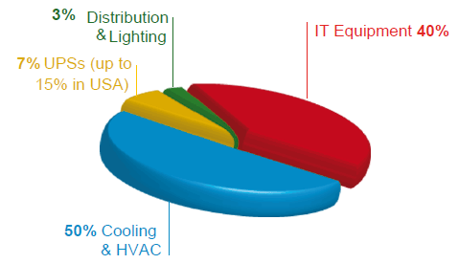
Motivation
Situation today:
  ICT sector is responsible for around 2 % of the global energy consumption
  Energy consumption in a data centre:
    Result of executing workloads (user jobs) on (HPC/Cloud) resources
    Energy consumptions depends on:
      workload (jobs)
      application type (nature of jobs)
      Efficiency of HW resources (and usage level)
      Cooling efficiency (depends on environmental conditions and heat load)
  In many data centres, 50 % of the energy is consumed by cooling (resulting in bad energy efficiency)
→ energy savings are addressed in CoolEmAll and Eco2Clouds projects

Slide 4

Motivation
CoolEmAll - focus on building energy efficient data centers (taking a holistic approach)
Eco2Cloud - focus on energy-efficient cloud-application deployment in federated cloud-environments
Both projects make use of energy-efficiency metrics
  to describe application profiles (resource usage)
  to assess efficiency of data center- and cloud resources
  to assess energy-costs of application and workload execution for various data center granularity levels and -sites.
  Purpose of this presentation is to show overlaps between the both projects, addressing:
    Approaches and metrics used within the both projects

Slide 5
Coolemall

Slide 6
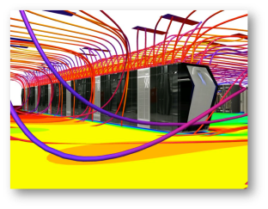
CoolEmAll Goal
CoolEmAll EU Project: www.coolemall.eu
Goal:
improve energy-efficiency of modular data centers by optimization of their design and operation for a wide range of workloads, IT equipment and cooling options
Main results:
  Simulation, visualization and decision support toolkit (SVD Toolkit), allowing optimisation of modular data centre building blocks a for wide range of options
  ComputeBox Blueprints and Data Centre Efficiency Building Blocks (DEBBs), reflecting HW and facility-configuration/models on various granularity level, used by SVD Toolkit.
  DEBBs are well described by energy-efficiency metrics
Notes:
improve energy-efficiency of modular data centers by optimisation of their design and operation for a wide range of workloads, IT equipment and cooling options
To enable data centre designers and operators to reduce energy impact of data centres by combining optimization of IT equipment, cooling and workload- management
important holistic approach to reduction of energy consumption including IT equipment, cooling infrastructure, and workload management
how it will be achieved?
by enabling advanced predictive analysis based on simulations
In particular
SVD (tools for forecasting energy consumption and performance)
ComputeBox and DEBBS (former good practises, latter more formal definition to be applied to simulations)
Details of these resutls will be presented and demonstrated throughout the review
Now I would like to explain what will be their advantage and added values for users…

Slide 7
CoolEmAll Approach
Data Center efficiency Building Blocks (DEBB) –models of IT equipment on various scale level
Scale
Rack(s)
Container(s)
Density
High density (up to hundreds nodes in a rack)
Low density
Cooling
Integrated
No integrated cooling
Arrangement
Position
Application types
HPC
Virtual machines
Application characteristics
CPU-bound
IO-bound
Scale
Workload mngmt policies
Workload consolidation
Energy-aware policies
Thermal-aware policies
Visualisation
Air/heat flow distribution map
Evaluation Metrics
Cooling / Airflow related metrics
Energy/Power related metrics (PUE)
Productivity metrics
Interaction
Rearrangement
Env. Conditions
...
CRAC
Higher server room temperature
Free air cooling
Liquid cooling
Notes:
The strength of CoolEmAll lies in its customization possibilities – interactive analysis of various dynamic scenarios and configurations…
First – to facilitate simulations by predefined blocks used as an input
Second – That allows to study data center energy-efficiency from perspective of users – taking into account their constraints, requirements and specific workloads, application, management policies

Slide 8
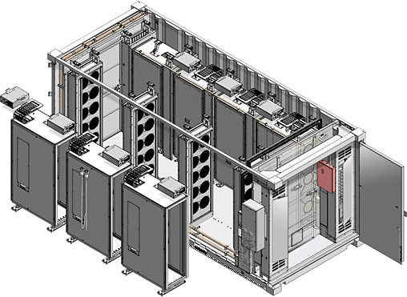
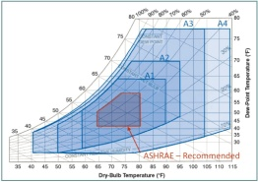
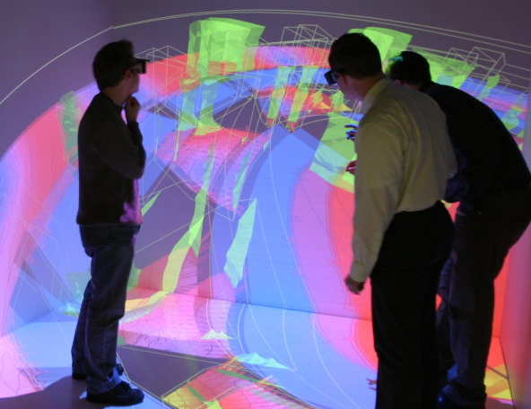
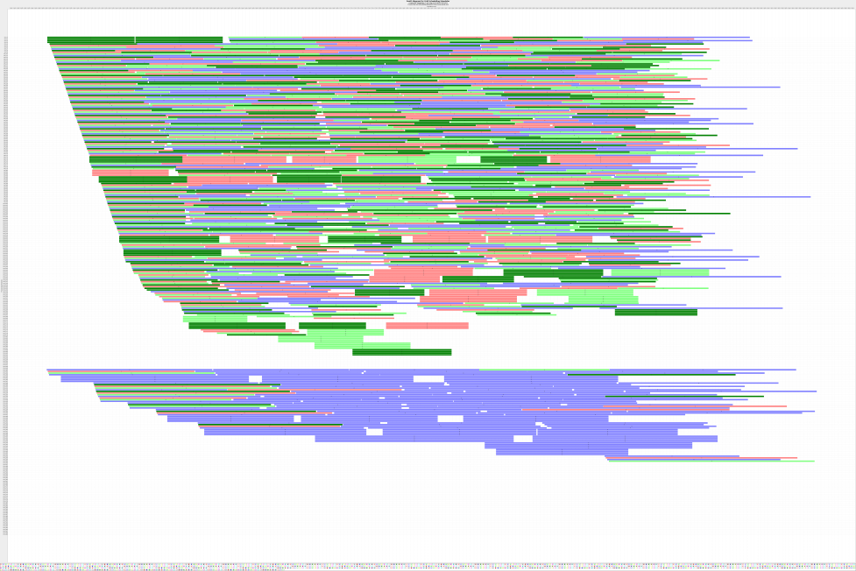
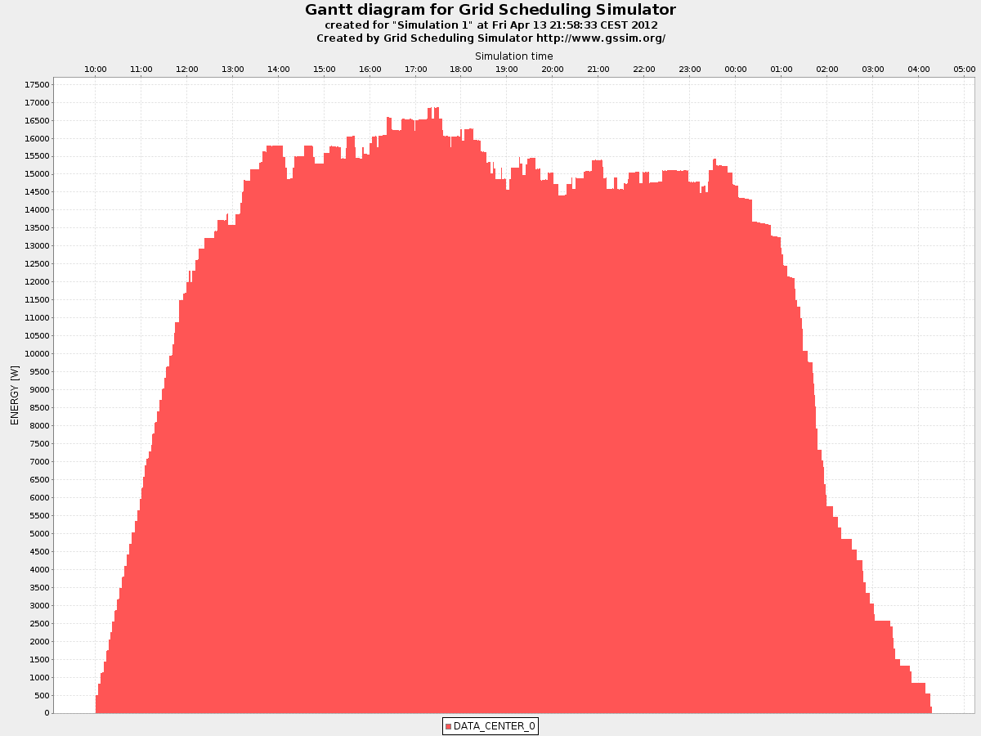
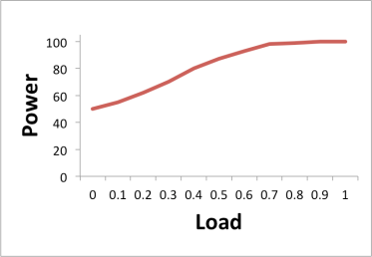
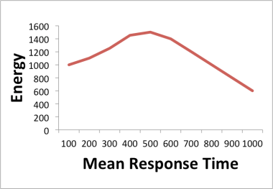
Holistic approach
Integrated analysis of workloads, IT equipment, and heat transfer
Coupled Simulation
Workload- and HW behavior
Simulation of cooling and heat processes
(air + liquid)
Energy-Efficiency Metrics to assess simulation results
Metrics Calculation
CFD Simulation
Workload and Resource Simulation
User Driven Optimization Cycle (Plan, Do, Check, Act):
Plan: Select/Set input parameters
Do simulation; Check assess results; Act: Decide on Changes
Notes:
One of the main CoolEmAll goals is delivering models and simulation tools (SVD Toolkit) for integrated analysis of various aspects affecting the overall energy-efficiency of data centres. These aspects include:
Characteristics of workloads and profiles of applications executed in a data centre,
Parameters and architecture of IT equipment,
Cooling type and heat transfer processes.
One of the main CoolEmAll differentiators is that it allows users of its simulation toolkit to conduct, apart from CFD simulation and advanced visualisation, detailed simulations of workload execution. Instead of rough mean power estimates the SVD Toolkit simulates execution of workloads with specific application profiles on specific hardware. In this way, we do not use just nameplate power values but get a detailed study of both energy-efficiency and performance for specific settings and workloads. To this end CoolEmAll is working on the use of detailed Discrete Events Simulations (DES) in addition to Computational Fluid Dynamics (CFD) analysis. By integration of these two approaches CoolEmAll aims at enabling unprecedented analysis of energy savings, time, cost, and availability.
To perform such an analysis appropriate metrics should be used since simple mean/max energy consumption or Power Usage Effectiveness (PUE) are insufficient to find relations between all criteria listed above. Hence, CoolEmAll is working on analysis of existing metrics as well as proposing the new ones to ensure that the following dependencies can be assessed:
- Scalability of energy-efficiency with respect to the load of data centres,
- Trade-off between overall performance and energy consumption,
- Productivity per energy for specific types of workloads and data centres,
- Balance of dissipated heat and its impact on energy-efficiency.
To this end, we consider (among others) metrics such as FVER, PUE scalability, pPUE, Imbalance of heat generation.
CoolEmAll provides mainly modeling and simulation tools so energy savings depend largely on given scenario and architecture. However we identified a few main use cases including (i) re-arrangement of racks based on CFD simulations (e.g. optimising air ducts, additional curtains, etc.), (ii) capacity management (selecting optimal configuration of hardware for given types of workloads), and (iii) free cooling or increasing temperature in a server room (finding a maximum inlet temperature so that data centre can operate for a given workload and configuration). Even for each of use cases final savings will depend on a specific configuration, technology and state before improvements. However, rough potential savings obtained by using the CoolEmAll SVD Toolkit for each of these use cases are the following:
Rack re-arrangement: improved air flow (avoiding hot and cold air mixing, heat recirculation, etc.) can lead to 25% savings for racks cooled by CRAC
Capacity management: optimal selection of IT equipment and its configuration for given application profiles and workload levels can help to reduce energy consumption by 20%; additionally it can cause performance gains
Free cooling: 30% of energy can be saved by no use of chillers,
Increasing temperature of server room: up to 4% per 0.5 Celsius degree increase can be achieved
Using CoolEmAll tools it is possible to test policies that minimise or prevent losses in performance and availability. For example, optimal selection of allocation of application to hardware and its power state can be done dynamically. Another example is a policy that reduces hot spots to enable free cooling (or increased temperature) operation but looks for a trade-off with workload execution performance.

Slide 9

DEBB
What is a DEBB?
  Data Center Efficiency Building Block
  The DEBB is an abstraction for computing and storage hardware and describes energy efficiency of data-center building blocks on different granularity-levels.
Purpose: To find the most energy efficient configuration while planning a data center
  Used for thermodynamic modeling (SVD Toolkit)
  Used for configuration and reconfiguration
Availability
  To be publicly available
  Defined according to open specification

Slide 10
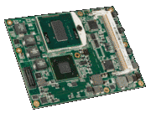
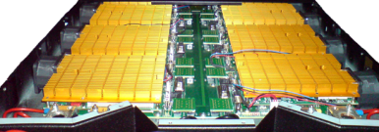
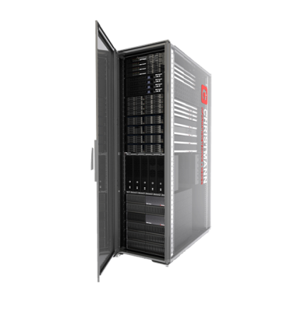
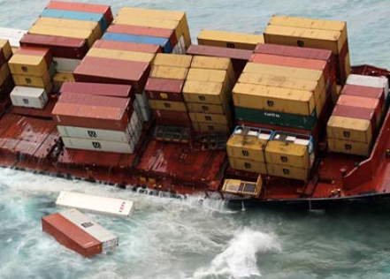
DEBB Granularity Levels
Granularity-levels
  Node unit
  single blade CPU unit
  (for instance a RECS CPU module)
  Node group
  assembled unit of node units
  (for instance a complete RECS18)
  ComputeBox1
  reflects a typical rack
  ComputeBox2
  Reflects a container or a
  Data Centre filled
  with racks and
  additional infrastructure

Slide 11
ECO2Clouds

Slide 12
Eco2Clouds Goal
Eco2clouds EU Project: www.eco2clouds.eu
Goal:
The overall goal is the introduction of ecological concerns (energy efficiency or CO2 footprint) while developing cloud infrastructures or cloud-based applications.
Focus on energy-aware application deployment and execution on the cloud infrastructure in federated environments, reducing energy consumption and CO2 emissions
  Main results:
  energy aware deployment strategies,
  Models, Architectures, SW tools, design guidelines
Notes:
ECO2Clouds will design and implement an energy aware deployment strategy for multi-site cloud faciliti
The overall goal is the introduction of ecological concerns (energy efficiency or CO2 footprint) while developing cloud infrastructures or cloud-based applications. es.

Slide 13

Eco2Clouds approach
ECO2Clouds scheduler controls and manage the execution of cloud services dynamically, with respect to combine:
  power consumption
  processing performance
  in an optimal fashion keeping the overall optimum
For measuring the greenness of an application (deployment of an execution), several metrics are considered on following levels:
  physical infrastructure
  virtual infrastructure,
  service infrastructure
  the whole datacenter

Slide 14
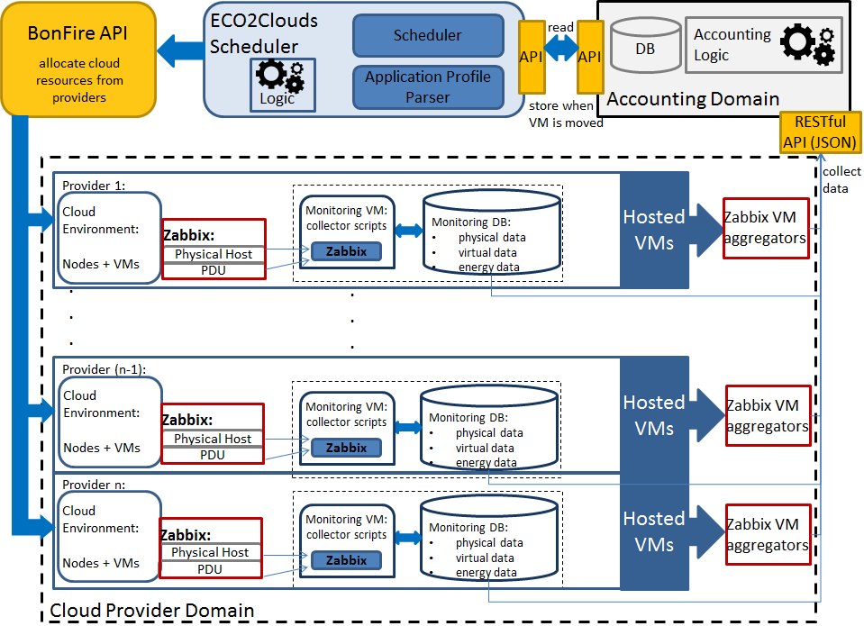
Eco2Clouds - Architecture

Slide 15
Comparison of Approaches

Slide 16
Comparison criteria
Approach type: simulation/model based vs. real/situation based
Data Center lifecycle phases: planning, design, construction, commission, turnover & transition, operation
Granularity level: node, node-group (server), rack, data center, federation of data centers
Application type: HPC, Cloud
Level of details: how complex are models covered in scope of the approach (high, medium, low)
Scope: how broad is the scope covered within the approach, metered in terms parameters taken into account

Slide 17
Comparison of approaches

Slide 18
Comparison of Metrics

Slide 19
Comparison of layers
GAMES GPI | Eco2Clouds | CoolEmAll
Organization | Organization | Out of the focus of CoolEmAll
Facility | Cloud Site | Data Centre
 |  | Rack
Compute Node | Compute Node | Node-Group
 |  | Node
 | Virtualisation | Addressed in scope of (cloud) applications
Application | Application, Services | Application (HPC, Cloud)

Slide 20
Metrics
Resource Usage metrics: characterize the IT resource (CPU, CPU, Memory, I/O, Storage, Network) usage of applications and their environment. Their utilization can be measured on various level of granularity.
Energy metrics: It includes metrics addressed to the energy impact of data centre considering all its components and subsystems, whereas are distinguished:
  Power-based metrics: Metrics defined under power terms. The information provided is useful for designers because it drives to peak power measurements.
  Energy-based metrics: Metrics defined under energy terms where the time of the measurement must be chosen.
  Heat-aware metrics: The heat-aware metrics take into account temperature to characterize the energy behavior of the data centre building blocks.
Green metrics: These metrics describe the impact of the operation of a data centre in the natural environment.
Financial metrics: These metrics describe the financial impact of the operation of a data centre in a business organization.

Slide 21
Node level

Slide 22
Node-Group level

Slide 23
Data Center level

Slide 24
Data Center level

Slide 25
Virtualization level

Slide 26
Conclusion on metrics
Many metrics are very similar
(as they originate from the GAMES project)
The difference between the few metrics is a result of
  different approaches
  project-focuses
  addressed life-cycle-phases
  Spectrum
  supported application-types

Slide 27
Summary

Slide 28

Summary
Description of the both projects: CoolEmAll and Eco2Clouds
Comparison of approaches:
  CoolEmall – simulation based assessment
  Eco2Cloud – situation based assessment
Comparison of metrics:
  Very similar – as they originate from the GAMES
  Differences – result of approaches
Potential for combination of the both approaches in several ways:
  According to data center life-cycle
  Moving Eco2Clouds towards model based approach
  Apply Eco2Clouds monitoring infrastructure to calibrate CoolEmAll models

Slide 29

Questions?
Email: volk [at] hlrs.de

