Slide 1
Experimental Awareness of CO₂ in Federated Cloud Sourcing
ECO₂Clouds team
Barbara Pernici, Politecnico di Milano

Slide 2






Overview ECO₂Clouds
Partners: 6
Project type: STREP
Duration: 24 months
Start date: October 1, 2012
Work programme topic addressed:
Objective-ICT-2011.1.6 c) Fire Experimentation
Web site: http://eco2clouds.eu

Slide 3
ECO2Clouds rationale and motivation
Rapid proliferation of cloud-based IT infrastructures
Ecological implications form a gap in current state of the art in research and practice
To date little is known about how to incorporate carbon emissions and energy consumption into application
development and deployment decision models.
Addressing this gap is vital to have an impact on future sustainable developments

Slide 4
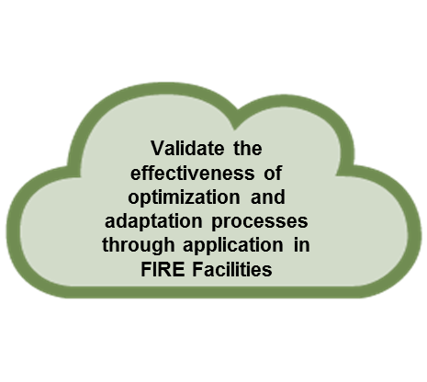




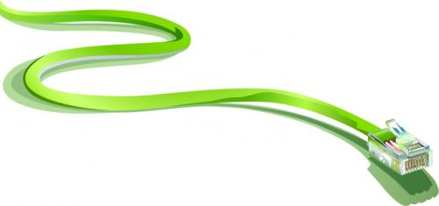
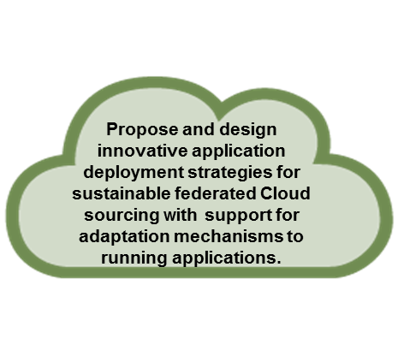

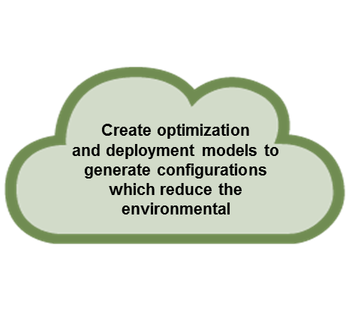






Advancing ecological awareness in the Cloud
Optimization of Energy Consumption in the Cloud Infrastructure
ECO₂Clouds develops key metrics to express energy consumption and CO₂ footprint of Cloud Facilities and Cloud Applications for quantification of their environmental impact.
Validate effectiveness
CONSORTIUM
Strategies for Energy Efficient and CO2 Aware Cloud Applications

Slide 5

Project overview: objectives
Create extensions to the Cloud application programming interface and mechanisms to expose eco-metrics at the levels of applications, VM, and infrastructure.
Complete implementations to collect key eco-metrics at VM and infrastructure level by leveraging consumption probes of physical nodes and assigning the measured consumption to virtual machines in a Cloud infrastructure.
Develop software to implement the optimization and deployment models while ensuring infrastructure support for the deployment models and adaptation process.
Validate the effectiveness of the proposed optimization and deployment models and adaptation process through challenging application case studies

Slide 6
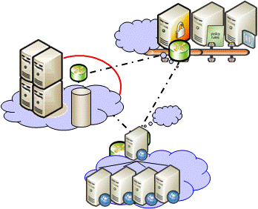


ECO₂Clouds use of BonFIRE
Eco-metrics
monitoring
Observability
Control
Advanced features
Case studies
Deployment optimization
CO₂ footprint
Integrate the carbon-aware mechanisms into BonFIRE so as to test, validate and optimize the eco-metrics, models and algorithms developed
… adding the ECO dimension to FIRE

Slide 7
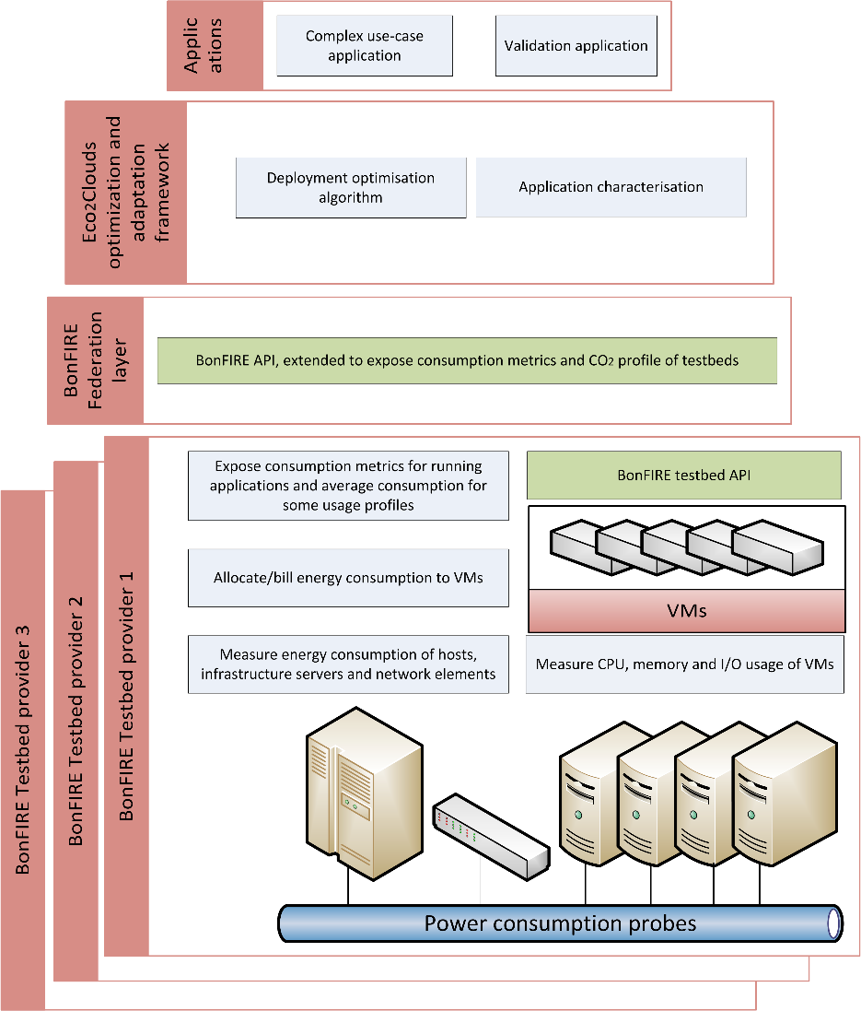
Three gardens
USTUTT-HLRS Data Center
The ECO₂Clouds site USTUTT-HLRS runs OpenNebula 3.6 in a dedicated version derived for BonFIRE.
Resources: 17 dedicated worker nodes and 36 on-request nodes
EPCC Data Center
UK-EPCC runs OpenNebula, in a version derived from OpenNebula 3.2 for BonFIRE.
Resources: EPCC provides 3 dedicated nodes as permanent resources. Two of these nodes offer four, 12-core AMD Opteron 6176 (2.3GHz)
Inria Data Center
FR-Inria runs OpenNebula, in a version derived from OpenNebula 3.6 for BonFIRE.
Resources: 4 dedicated worker nodes (DELL PowerEdge C6220 machines) and can expand over the 160 nodes of Grid‘5000 located in Rennes.

Slide 8
Implementations
All 4 layers are considered
  Energy
  Physical
  Virtual
  (Service)
    User needs to implement this type due to application differences!
Include additional templates
  Infrastructure aggregator
  BonFIRE aggregator

Slide 9
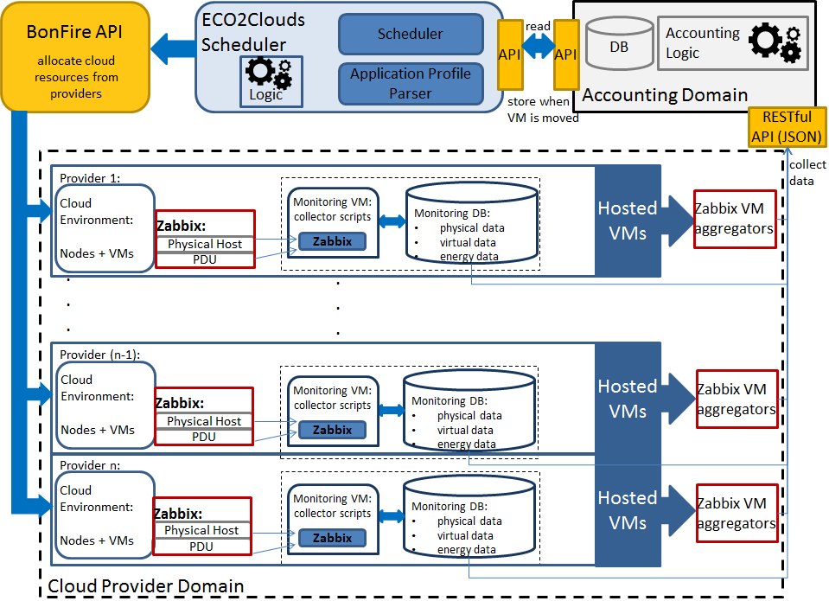
ECO2Clouds Architecture

Slide 10
Metrics: infrastructure layer
Host
Site

Slide 11
Metrics: virtualization layer

Slide 12
Metrics: application layer

Slide 13
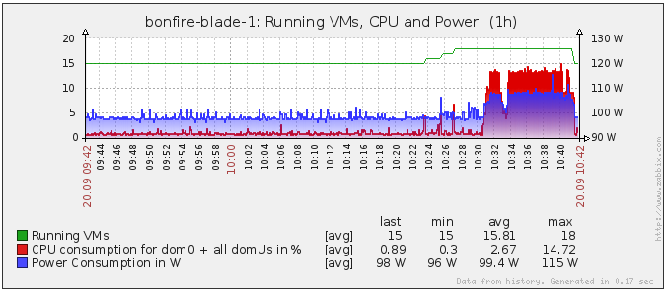
Monitored metrics – example
Source: Inria

Slide 14
Metrics: Energy Consumption
Energy consumption is measured by
  PDUs
  Energy sensors (blade servers at HLRS)
Available at INRIA, HLRS and EPCC
  PDU scripts, usable at provider sites
Energy Metrics:
  calculated by use of PDU/sensor data
  calculated by use of energy mix statistics

Slide 15
Greenhouse Gas metrics - Energy mix
Live data at INRIA and EPCC
Static values at HLRS
  Fixed by contract

Slide 16
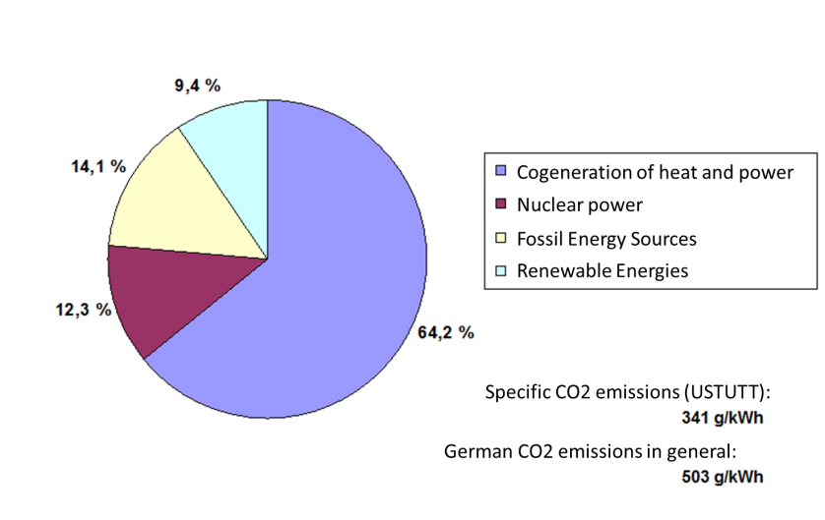
Energy mix at HLRS
fixed values at HLRS

Slide 17
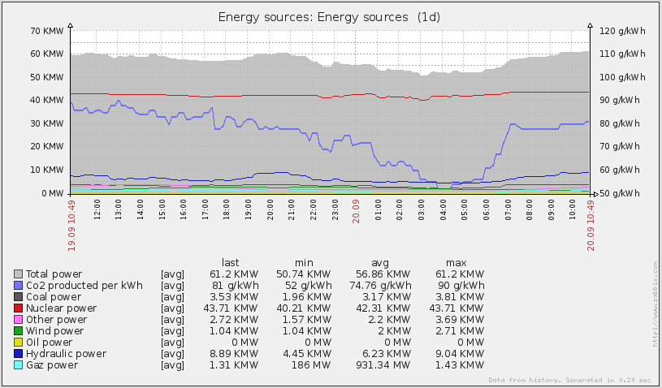
Energy mix at Inria – live feed from France’s electricity transport company (RTE)

Slide 18
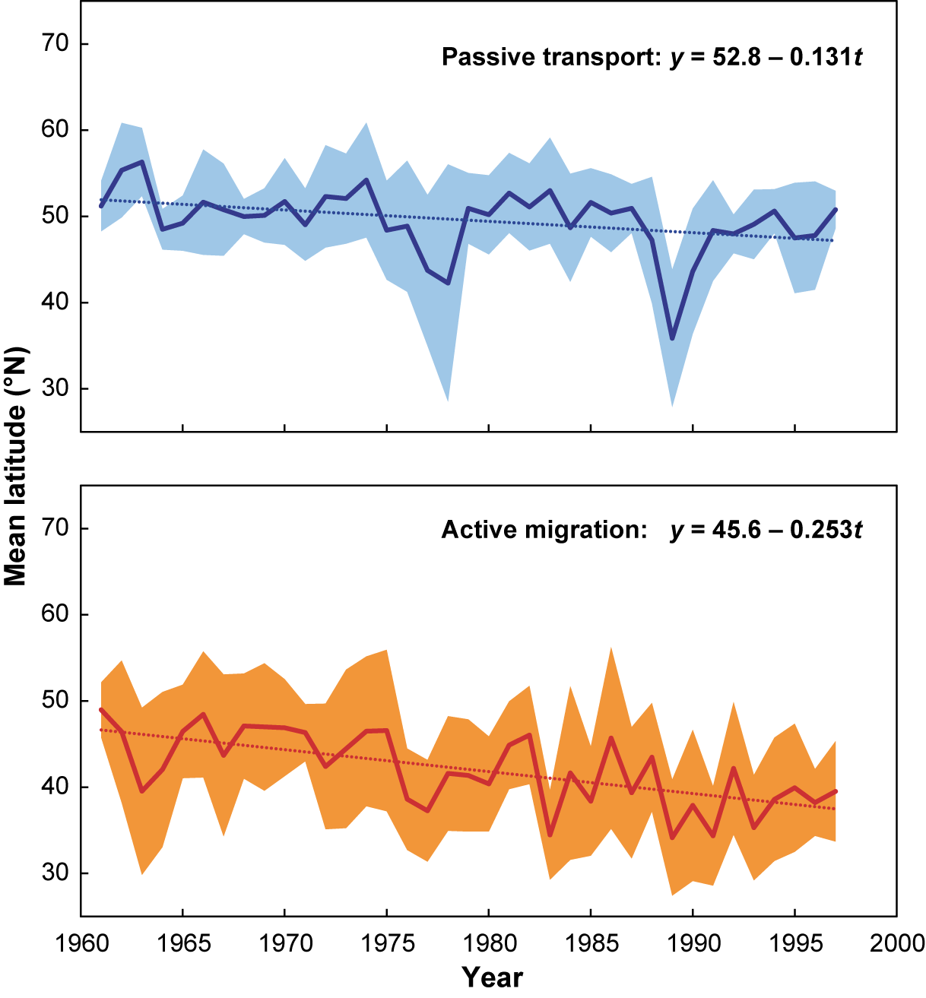
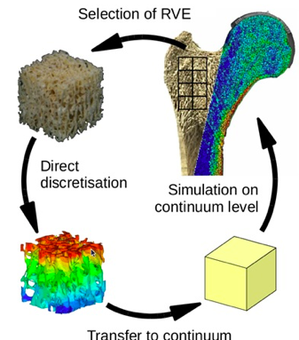
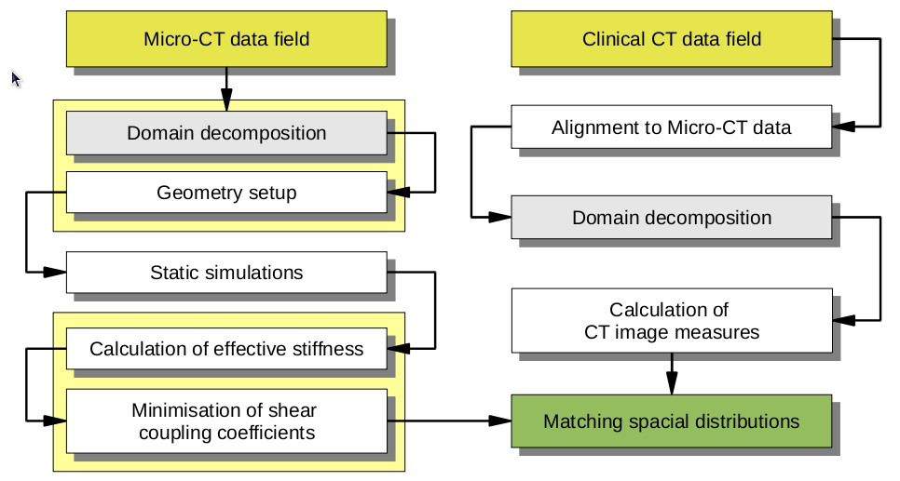
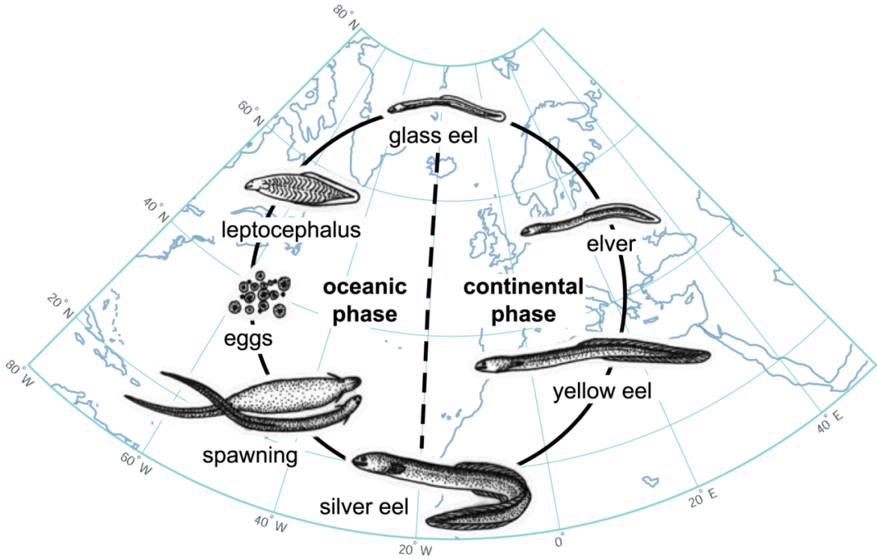
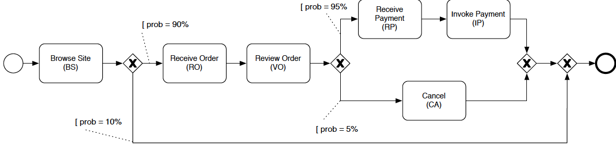
Case studies
Latitudinal trend of arrivals
(40-yr simulations)
Data analysis in clinical domain
HPC
Eels case study
    HPC
e-business with services

Slide 19
Future Work
Derive new requirements from ongoing experimentation
Selection of more suitable eco-metrics at different levels
Data mining solution
Optimization:
  Application deployment strategies (configurations of requested resources)
  Design-time advanced scheduling
  Runtime adaptation

Slide 20
QUESTIONS?
Further information:
  http://eco2clouds.eu
Contact – project coordinator:
  Julia Wells, Atos Spain

Slide 22
ADDITIONAL BACKUP SLIDES

Slide 23
Project overview (i): Objectives
Develop key metrics to express energy consumption and CO2 footprint of Cloud facilities and applications to support application deployment strategies and quantification of their environmental impact.
Create an optimization and deployment model to generate configurations which reduce the environmental impact when the workload is mapped to infrastructure and Virtual Machine (VM) level.
Design innovative deployment strategies for sustainable federated Cloud sourcing while supporting adaptation mechanisms that can perform changes to running applications based on energy consumption and carbon emissions.

Slide 24
Project overview (ii): objectives
Create extensions to the Cloud application programming interface and mechanisms to expose eco-metrics at the levels of applications, infrastructure and VM.
Complete implementations to collect key eco-metrics at VM and infrastructure level by leveraging consumption probes of physical nodes and assigning the measured consumption to virtual machines in a Cloud infrastructure.
Develop software to implement the optimization and deployment models while ensuring infrastructure support for the deployment models and adaptation process.
Validate the effectiveness of the proposed optimization and deployment models and adaptation process through challenging application case studies

Slide 25

Project overview (iii)
Overview of S&T Approach
Evaluate current Cloud sourcing practices and deployment strategies
    Mechanisms for monitoring of energy consumption and CO₂ footprint
    Identify other factors such as SLAs, cost, QoS etc
Investigate novel approaches
    Mechanisms for monitoring
      Energy consumption (applications, Cloud resources)
      environmental impact (i.e. CO₂ footprint) of Cloud deployment
    Application deployment optimization and adaptation strategies
Bridge the gap between
    Availability of energy consumption data (applications, Cloud infrastructure)
    Capability to formulate deployment strategies for energy efficient utilization of Cloud resources

Slide 26
How to experiment with the ideas of ECO2Clouds ?
ECO₂Clouds will extend the BonFIRE testbed for experiments.
  Hardware probes to monitor energy consumption of as much of the local infrastructure as possible
  Software probes to monitor VM usage of hardware resources
BonFIRE APIs to be extended to support this use-case
  Testbed API accessed through experiment manager to expose energy sourcing
  Monitoring infrastructure to expose energy related metrics
    VM metrics as viewed by the host
    Energy consumption of the host and of the infrastructure

Slide 27
How to optimize cloud sourcing to take into account CO₂ impact ?
Cloud providers need to expose CO₂ information
  Providers able to expose or quote estimated CO₂ consumption according to VM size and usage metrics
  Users get billed for the CO₂ impact of their cloud usage in proportion to CPU, memory, network and disk IO of their usage
    No attempt to expose the physical reality
  Providers guarantee all CO₂ costs are billed to users
    Metered electricity consumption, matched to energy sourcing information
An optimizer uses CO₂ information, application profiles and execution constraints to find the best provider of cloud resources

Slide 28
How to experiment with such ideas ?
ECO₂Clouds will extend the BonFIRE testbed for experiments.
  Hardware probes to monitor energy consumption of as much of the local infrastructure as possible
    No attempts to monitor network links
  Software probes to monitor VM usage of hardware resources
BonFIRE APIs to be extended to support this use-case
  Testbed API accessed through experiment manager to expose energy sourcing
  Monitoring infrastructure to expose energy related metrics
    VM metrics as viewed by the host
    Energy consumption of the host and of the infrastructure

Slide 29
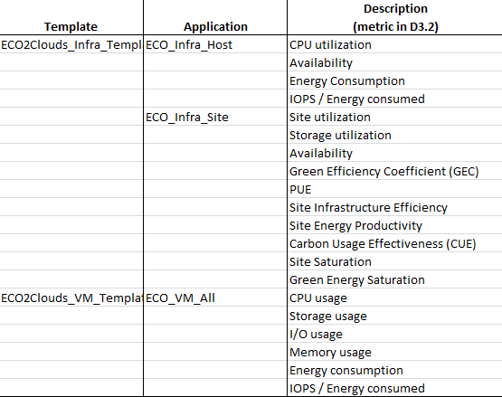
Implementations

Slide 30
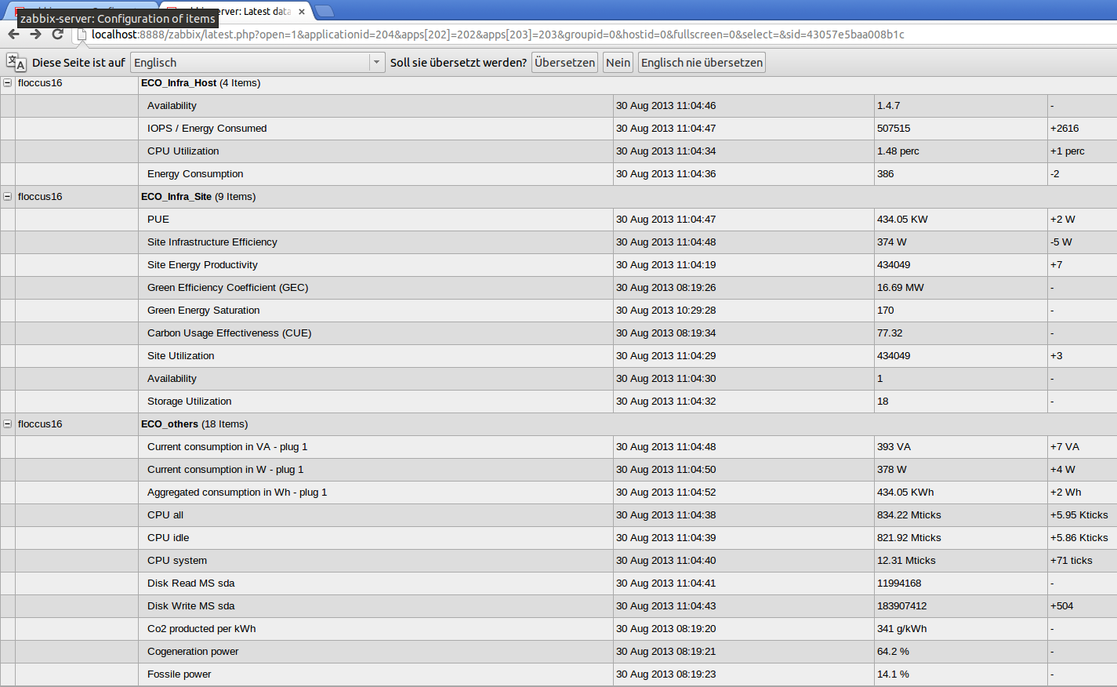
Metrics: Example (Infrastructure)
Energy
Consumption Metrics
ECO_others are required for calculating metrics

Slide 31
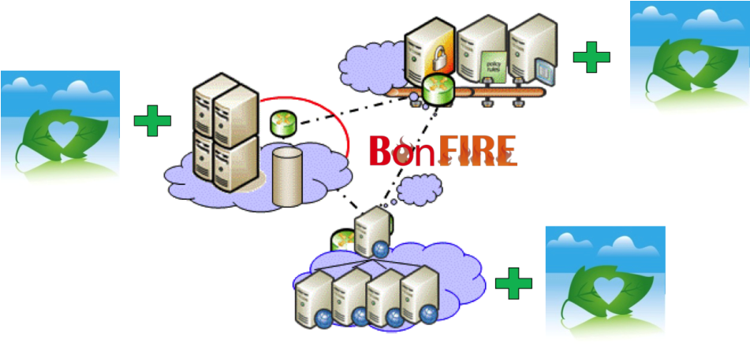
BonFIRE in a slide
A multi-site cloud facility for applications, services and systems research and experimentation
3 testbeds participating in ECO₂Clouds
Founded on 4 principles
  Observability
  Control
  Advanced features
  Ease of use
Presenter, Venue

Slide 32
Mapping achievements with Technical Objectives
T1. Create extensions to the Cloud application programming interface and mechanisms to expose eco-metrics (established at S1) at the levels of applications, infrastructure and VM
Configuration of PDUs (WP5)
Extensions to Zabbix API to expose infrastructure and VM level metrics (WP3 and WP5)
Application Dashboard (WP4)
T2.Complete implementations to collect key eco-metrics at VM and infrastructure level by leveraging consumption probes of physical nodes and assigning the measured consumption to virtual machines in a Cloud infrastructure
Collection and calculation of infrastructure related eco-metrics data (WP3)
Extensions to Zabbix API (WP3 and WP5)
Accounting service (WP4)
T3.Develop software to implement the optimization and deployment models while ensuring infrastructure support for the deployment models and adaptation process
Scheduler and related components (e.g. Parser, Accounting Service) (WP4)
Energy aware optimization of application deployment and techniques for run-time adaptation (WP4)
T4. Implement case studies to validate the scientific objectives and conduct a number of experiments to provide an assessment of the potential of the enhanced platform
Use case definition and adaptation

Slide 33
Layers and implementation
Energy
  Implemented
Physical
  Implemented
Virtual
  Implemented
(Service)
    User needs to implement this type due to application differences!

